Slide 1
Progress Report

Slide 2
Progress from last week
Result on Num of Coset vs. detection
Implemented methods treating output as independent binary classification
Tested the “divide and conquer” method
Improved GPU implementation

Slide 3
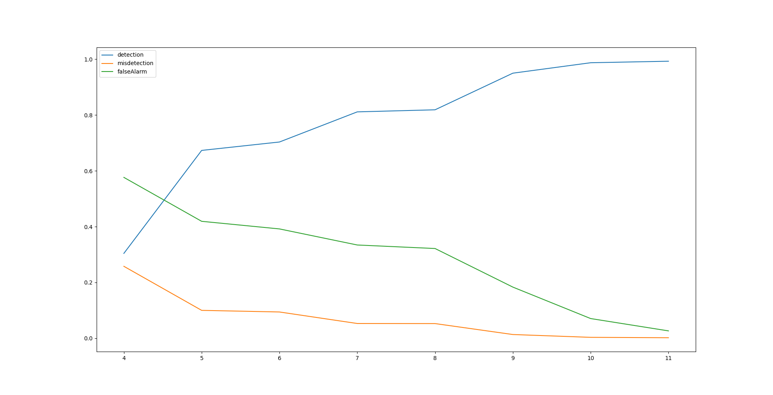
Num of Coset vs. detection

Slide 4
Summarizing all implementations
MSE(legacy)
  treat the output as a whole
  loss function is mean square error
  can work fine on 10/2/5(subband/occupied/coset)
  cannot work fine on 40/4/8
  discontinued
Custom loss
  treat the output as a whole
  loss function is customized, capturing false alarm and misdetection
  can work decent on 40/4/8

Slide 5
Summarizing all implementations 2
Cross entropy
  treat the output as a comb(40,4)=91390 length vector
  loss function is cross entropy
  [err,fal,mis,det] 40/4/8
  [[3.7450e-04 1.8725e-03 1.8725e-03 9.9589e-01]]
  showing excellent performance
  Not scalable as comb(40,8)=around 80m

Slide 6
Summarizing all implementations 3
Cross entropy split
  treat each subband as independent classification task
  scale much better than the previous implementation
  however, the accuracy and detection is around the same with the custom loss
    [err,fal,mis,det] 40/4/8
    [0.0073675 0.03261939 0.04135 0.8648 ]
    [[[0.0061775 0.0317187 0.03 0.8913 ]
    [0.0061575 0.02990607 0.031725 0.8875 ]
    [0.00656 0.03852232 0.0266 0.906 ]
    [0.00571 0.02916209 0.0279 0.9006 ]
  The training accuracy is around 96%-98%, inspecting why there is a gap
    Unbalanced class in training?

Slide 7
Summarizing all implementations 4
A minor detail on the last step of cross entropy split implementation
  variant A: each subband gets its own prediction as [p0,p1]
  each subband choose the larger one to be the predicted class
  Variant B: stack the result into a vector as [p1_0,p1_1,p1_2....p1_40]
  choose largest 4 as the prediction
Both methods ends with similar result in the small scale test
  when the accuracy is high enough, the result should be similar
  when the accuracy is low, variant b sounds like a better choice

Slide 8
“Divide and conquer” method
Old methods, especially cross entropy, do not translate well on 40/8 and larger cases
Could we fuse the neighbouring subbands, turning a 40/8 task into a 20/8 task?

Slide 9
“Divide and conquer” method 2
MSE, 40/4/8 shrink to 20, then 10
  [loss,detection,mis,fal]
  [[[[0.01445573 0.72568357 0.09038819 0.29807383]]] 40
  [[[0.03064675 0.66811526 0.09253871 0.33189815]]] 20
  [[[0.06377903 0.62354493 0.09433314 0.36151221]]]] 10
cross entropy split
  [err,fal,mis,det]
  [[[0.00451465 0.02030594 0.02493652 0.91745117]] 40
  [[0.00993262 0.0260455 0.02558069 0.78050781]] 20
  [[0.02076074 0.02800737 0.0304667 0.53251953]]] 10

Slide 10
“Divide and conquer” method 3
MSE, 40/8/16 shrink to 20, then 10
  [loss,detection,mis,fal]
  [[[[0.01622083 0.84389651 0.02286011 0.17552012]]]
  [[[0.03303145 0.6292578 0.01991893 0.21013752]]]
  [[[0.06597109 0.58260745 0.02277601 0.23542853]]]]
cross entropy split
  [err,fal,mis,det]
  [[[0.01072217 0.02607301 0.02757813 0.85249023]]
  [[0.01731152 0.02251977 0.02508096 0.79916016]]
  [[0.01861719 0.01429843 0.01640452 0.71198242]]]

Slide 11
“Divide and conquer” method 4
why is the result not good?
  possible bug in cross entropy split implementation, as shown by the detection drop compared to accuracy
  Although there are less classes overall, the classes are merged from smaller classes, if the smaller classes are not neighbours in the original space, the problem could be as hard as the original problem
How to mend it?
  double check the implementation
  try another divide method: dividing a 40/8 problem to two 20/8 problems
    use the merge method mentined in variant b?

Slide 12
Other attempts
Implemented mse loss combined with custom loss
  Intended to use mse loss to limit the output positive numbers
  failed to achieve a decent balance between detection and misdetection
New quantify method for 1bit
  old: depends on the average energy of the signal, when we only want 1 bit, results in horrible info loss
  new: use a fixed small threshold, treat it as +/- 1 if the energy exceeds it.

Slide 13
Work in progress
Debug the cross entropy split implementation
Frequency domain input
Comparision method

